Slide 1
Queuing Management System (Banking System)
ERP: Practical 2
JR Gouws
u16033915

Slide 2
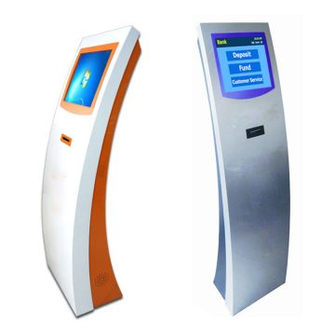
Scenario
Banks in particular aim to provide the best possible client satisfaction.
Client perspective
Shorter queues
Shorter waiting times
Shorter service times.
Banking owner perspective
Increase profit.
Ticket system requires information needed for a specific service and links information to ticket, with a banking assistant to speed up the process.
Looking at the ticket granting service
How many ticket granting servers?
Who gets preference?
Develop queuing management system to provide best solution.
Notes:
Picture reference [1]

Slide 3
System Requirements and classification
Customers are accepted into the bank between 08:30 and 16:30.
The bank will close at 16:30, but serve all customers that arrived before 16:30.
Different services are provided
Deposits and withdrawals
Banking statements
General banking services
Account opening
Loan or complicated banking service.
The services take different times to complete.
Customers arrive at different rates during the day.
Customers do not leave the system once entering.
Once a customer is serviced by a teller, the customer cannot be interrupted.
Important customers needs to be satisfied (valued customers or disabled).

Slide 4
System Requirements and classification
Arrival Process
Poisson distribution (independent)
The customers will arrive according to the time of day. At peak hours, the arrival rate will be high.
Customers types will be determined according to the probability of customers requesting a specific service.
Service Process
Poisson distribution.
Different service times according to the service they require.
Role of servers will differ according to customer arrival rate during the day.
System model - M/M/s

Slide 5
Design Factors
Inter-arrival times
Peak hours - 3 minutes per customer
Off-peak hours - 10 minutes per customer
Two priorities assigned
High priority - Highly valued customers and disabled customers
Low priority - Normal customers
High priority customers (5% of total customers)
Time of the day | Peak/Off-peak
08:30 – 10:00 | Peak
10:00 – 11:00 | Off-peak
11:00 – 13:30 | Peak
13:30 – 16:30 | Off-peak
Notes:
Table reference [2]

Slide 6
Design Factors
Service process
Service time depends on type of service required
Priority customers served without pre-emption and skip the line to the front.
Two servers will be used (ticket systems)
Service | Time required (minutes)
Require banking statements | 1
Deposits and withdrawals | 2
General banking services | 2.5
New account | 3
Loans | 5

Slide 7
Design Factors
Two queues will be used and two cases will be evaluated
First case
Second case
Both servers provides all the services available
Assume customers do no leave queue
Assume an infinite amount of waiting places
Assume customers of each priority serviced with first-in, first-out (FIFO) discipline.
Peak hours | Off-peak hours
Queue for banking statements, deposits, withdrawals and general banking services. Queue for new accounts and loans. | Two queues with identical services. Assume customers pick the shortest queue.

Slide 8
Design Factors
Queuing model: Continuous-time Markov chain
Real life factors
Power outage or network error
Customers wait a maximum of 15 minutes in the queue
If system does not recover after 15 minutes, assume system restarts with no queue
During the 15 minutes, customers arrives at the same rate
If system recovers, the system continues with added customers
Server fails
If one server fails, the other server takes control and is capable of providing any service
The working server receives all the customers of the broken server, joining at the back of the queue.
If both servers fails, the system restarts.

Slide 9
Design Parameters
The system will be evaluated by comparing
Queue length
Average waiting time
This will be done for the system as a whole for two cases
Both servers provides the same functions
Servers provides different services based on the arrival rate of customers.

Slide 10
Quality of Service

Slide 11
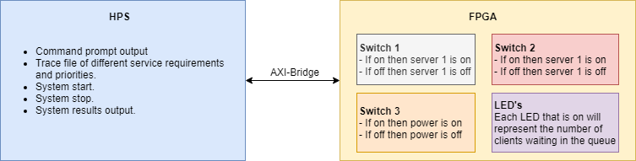
FPGA implementation

Slide 12
References
[1] 17-Inch Touch Screen Ticket Dispenser Kiosk for Bank Queue System Sx-Q173. 2019.
[2] Cowdrey, Kevin & Lange, Jaco & Malekian, Reza & Wanneburg, Johan & Jose, Arun. (2018). Applying Queueing Theory for the Optimization of a Banking Model. 10.13140/RG.2.2.32707.71207.

